Slide 1
Data Organization and Retrieval (Data Structures as Data Organization)
Subhasis Bhattacharjee
Computer Science & Engineering, IIT Jammu

Slide 2
Outline
Data structures concepts
ADT
Concept of Container
Ordering of data
Relations among data

Slide 3
Conceptual framework
Data structures for efficiently storing, accessing, and modifying data
Algorithms for solving problems efficiently
All data structures have trade-offs
There is no ultimate data structure...
The choice depends on our requirements

Slide 4
Example Trade-offs
Consider accessing the k^{th} entry in an array or linked list
In an array, we can access it using an index array[k]
We must step through the first k – 1 nodes in a linked list
Consider searching for an entry in a sorted array or linked list
In a sorted array, we use a fast binary search
Very fast
We must step through all entries less than the entry we’re looking for
Slow

Slide 5
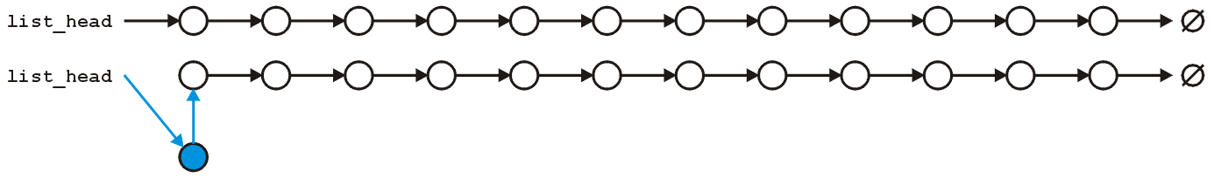
Example Trade-offs (contd.)
However, consider inserting a new entry to the start of an array or a linked list
An array requires that you copy all the elements in the array over
Slow for large arrays
A linked list allows you to make the insertion very quickly
Very fast regardless of size

Slide 6
Fundamental Components of Data Structures
Storage of objects / data
Ordering of data
Creation / initialization
Accessing of stored data
Adding / Updating of data
Removing / deleting of data
Union / Merge of data
Finally, how efficiently each item / all items are done.
Efficiently => time, space, simplicity, robustness, scalability, performance
Abstract Data Type: Not concern about implementation

Slide 7
Abstract Data Type (ADT)
In engineering, we tend to see certain patterns that occur over and over in applications
In these circumstances, we first name these patterns and then proceed to define certain standard solutions or implementations
Storing objects and relationships in containers, there are reoccurring containers of objects and associated relationships where the actual queries and operations are restricted
We model such containers by Abstract Data Types or ADTs

Slide 8
Abstract Data Type (ADT) - Designing
What are the relationships on the objects?
What queries will be made about the objects in the container?
What operations will be performed on the objects in the container?
What operations may be performed on the container as a whole?
What queries will be made about the relationships between the objects in the container?
What operations may be made on the relationships themselves between the objects in the container?

Slide 9
Storage of data in Data Structures
Data must be stored in and accessed from
Main memory (RAM)
Secondary memory (Hard Drive)
A container describes structures that store and give access to objects
If stored in Secondary Memory =>
Bring some / all data into RAM
Process / resolve query or question
Update data if needed
And so on…

Slide 10
Operations on a container
Create a new container
Copy or destroy an existing container
Empty a container
Query how many objects are in a container
Query what is the maximum number of objects a container can hold
Given two containers:
Find the union (merge), or
Find the intersection

Slide 11
Usual operations on a container in STL
Constructor | Container()
Copy Constructor | Container( Container const & )
Destructor | ~Container()
Empty it | void clear()
How many objects are in it? | int size() const
Is it empty? | bool empty() const
How many objects can it hold? | int max_size() const
Merge with another container | void insert( Container const & )
Insert an object | void insert( Type const & )
Erase an object | void erase( Type const & )
Find or access an object | iterator find( Type const & )
Count the number of copies | int count( Type const & )
Iterate through the objects in a container | iterator begin() const

Slide 12
Handling duplicate data in a container
Require that all objects in the container are unique, or
Allow duplicate objects
Generally, unique data – but duplicate objects is often just additional, and sometimes subtle, code

Slide 13
Storing Data and Relationship
Need to store not only objects, but relationships between the objects
Consequently, we may have additional operations based on the relationships
Consider a genealogical database
We don’t only want to store the people, but we want to also make queries about the relationships between the people

Slide 14
Ordering of Data
Linear ordering
Implicitly defined (sorted list)
Explicitly defined (creation of linked list, queue, etc.)
Hierarchical ordering
Adjacency relation
Partial ordering
Equivalence relation

Slide 15
Operations on Linear Orderings
Queries:
What are the first and last objects (front and back)?
What is the kth object?
What are all objects on a given interval [a, b]
Given a reference to one object in the container:
What are the previous and next objects?
Operations that may be performed as a result:
Insert an object into a sorted list
Insert an object at either front / back / kth position
Sort a collection of objects

Slide 16
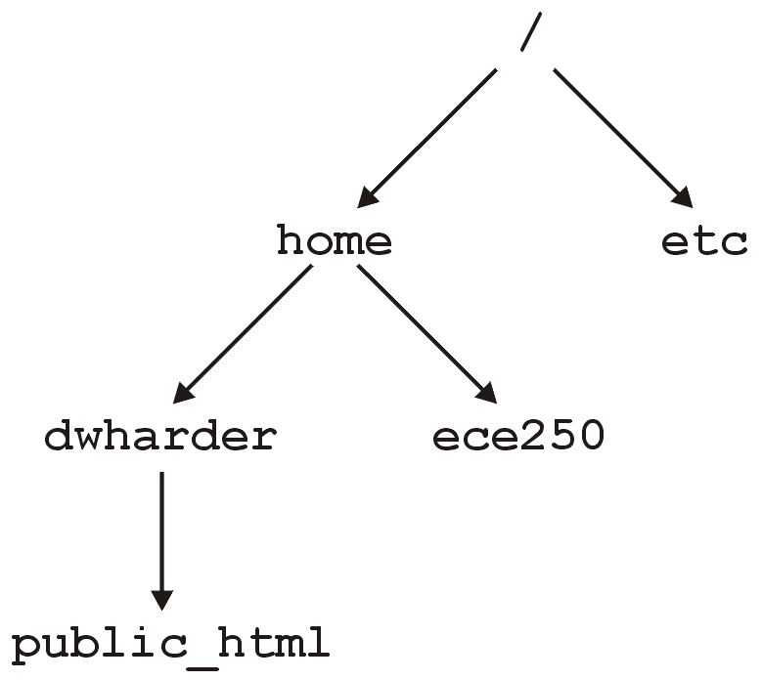
Hierarchical Orderings (example 1)
Consider directories in a file system:
x ≺ y if x contains y within one of its subdirectories
In Unix, there is a single root director /
Such structures allow us to organize information

Slide 17
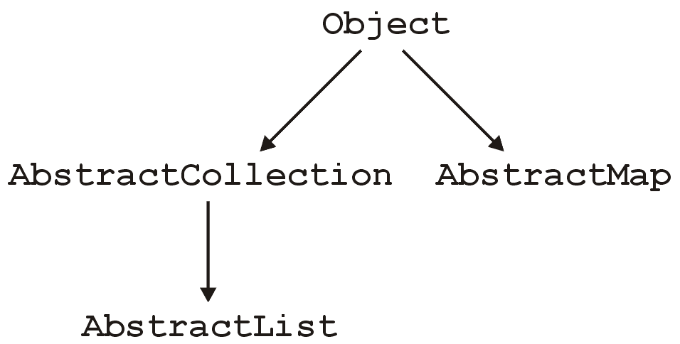
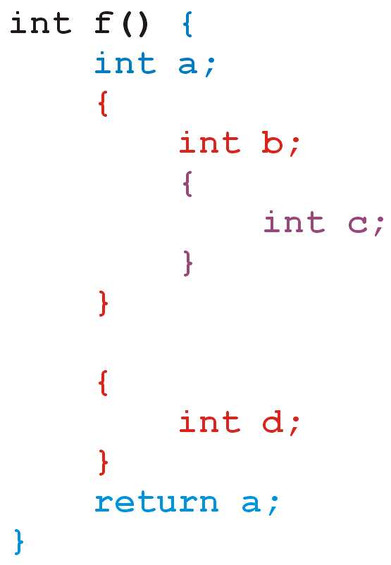
Hierarchical Orderings (example 2)
Java Object Hierarchy
Hierarchy of Variables in C Program

Slide 18
Operations on Hierarchical Orderings
If the hierarchical order is explicitly defined (the usual case), given two objects in the container, we may ask:
Does one object precede the other?
Are both objects at the same depth?
What is the nearest common predecessor?

Slide 19
Operations on Hierarchical Orderings
If the hierarchical order is explicitly defined (the usual case), given two objects in the container, we may ask:
Does one object precede the other?
Are both objects at the same depth?
What is the nearest common predecessor?

Slide 20
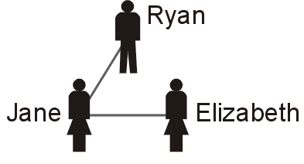
Adjacency Relation
x ↔ y if x and y are friends
Like a tree, such a relationship is displayed by a line connecting two individuals if they are friends (a graph)
E.g., Jane and Ryan are friends, Elizabeth and Jane are friends, but Elizabeth thinks Ryan is a little odd...

Slide 21
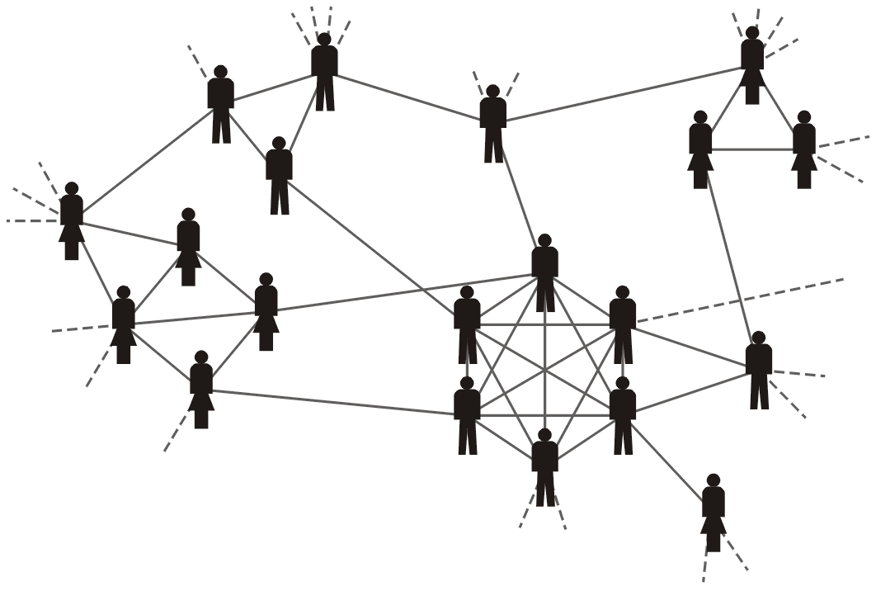
Adjacency Relation (example 2)
Two individuals who are related are also said to be adjacent to each other
eg, hockey team and some of their friends

Slide 22
Operations on Adjacency Relation
Who are adjacent to a node ?
Who are all connected to a node ?
What are two end nodes of an adjacency ?

Slide 23
Not in Syllabus (Partial Ordering, Equivalence Relation)

Slide 24
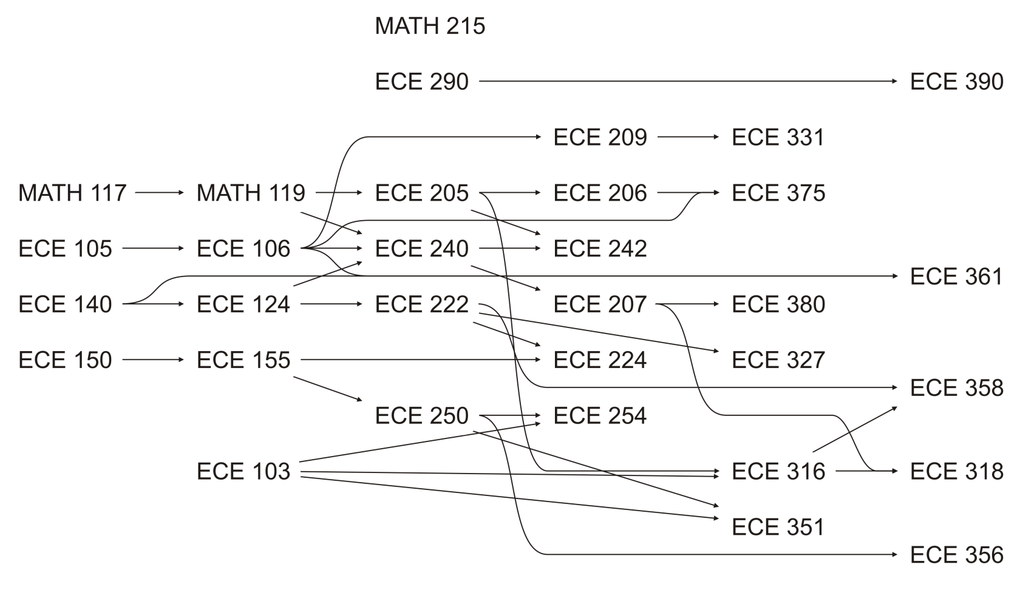
Partial Ordering
x ≺ y if x is a prerequisite of y
Not a hierarchy, as there are multiple starting points and one class may have multiple prerequisites
Arrows indicate the direction, & no loops

Slide 25
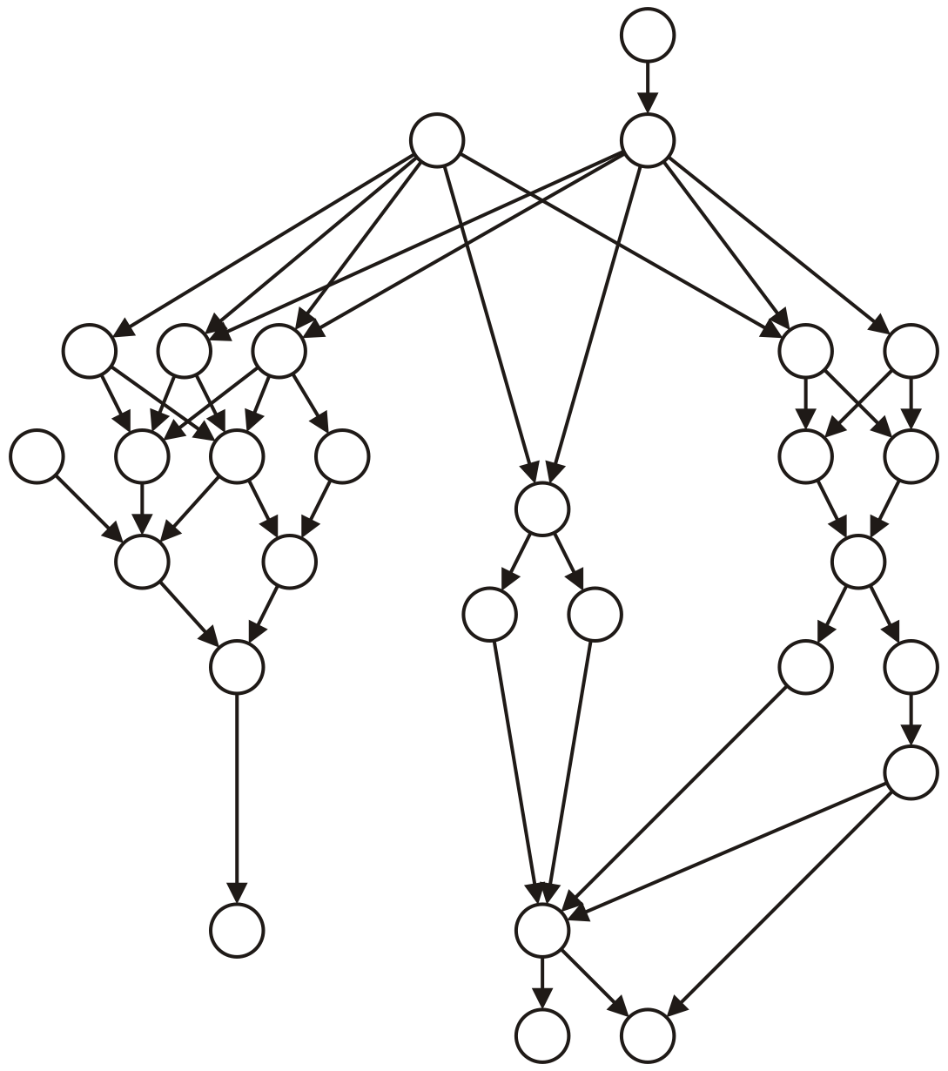
Partial Ordering (example 2)
C++ classes (multiple inheritance – a class can inherit from more than one class)
A number of tasks which must be completed where particular tasks must be completed before other tasks may be performed
Compilation dependencies
All partial orderings are anti-reflexive, anti-symmetric and transitive

Slide 26
Operations on Partial Ordering
Partial orders are similar to hierarchical orders; consequently, some operations are similar:
Given two objects, does one precede the other?
Which objects have no predecessors?
Not unique (unlike a hierarchy)
Which objects immediate precede an object?
A hierarchical order has only one immediate predecessor
Which objects immediately succeed an object?

Slide 27
Equivalence Relation
Consider the relationship
x ~ y if x and y are of the same gender
This relationship is reflexive, symmetric and transitive:

Slide 28
Operations on Equivalence Relation
Are two objects related?
Iterate through all objects related to one particular object
Count the number of objects related to one particular object
Given two objects x and y which are not currently related, make them related (union)
Not so easy: everything related to x must now be related to everything related to y

